Slide 1
Kano Tshark Activity
Group 3

Slide 2
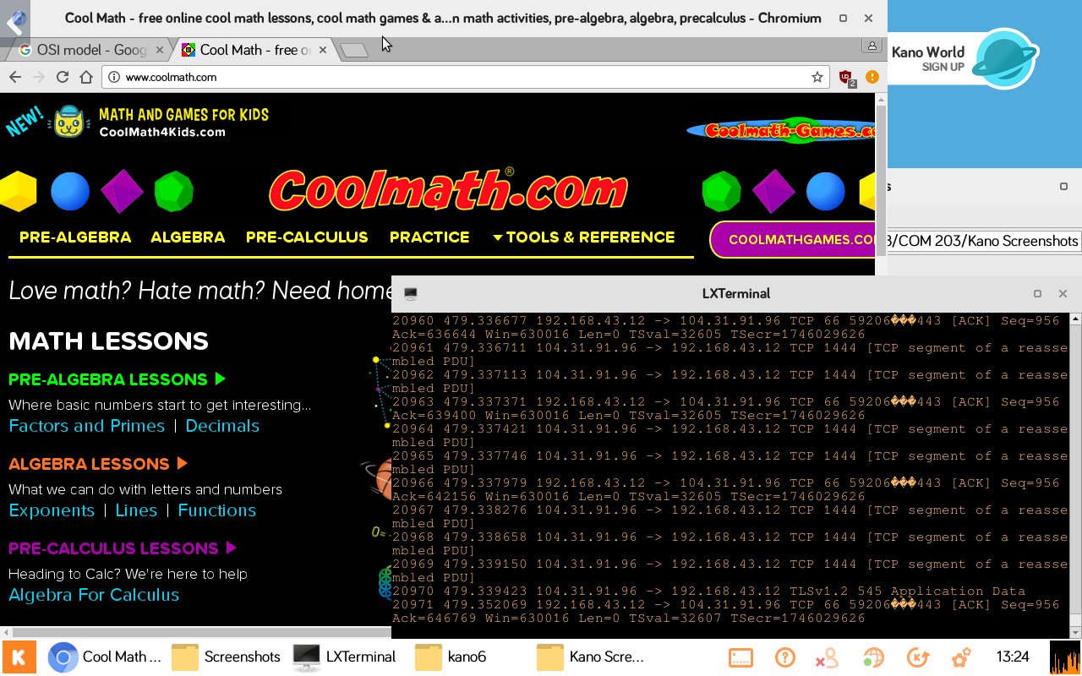
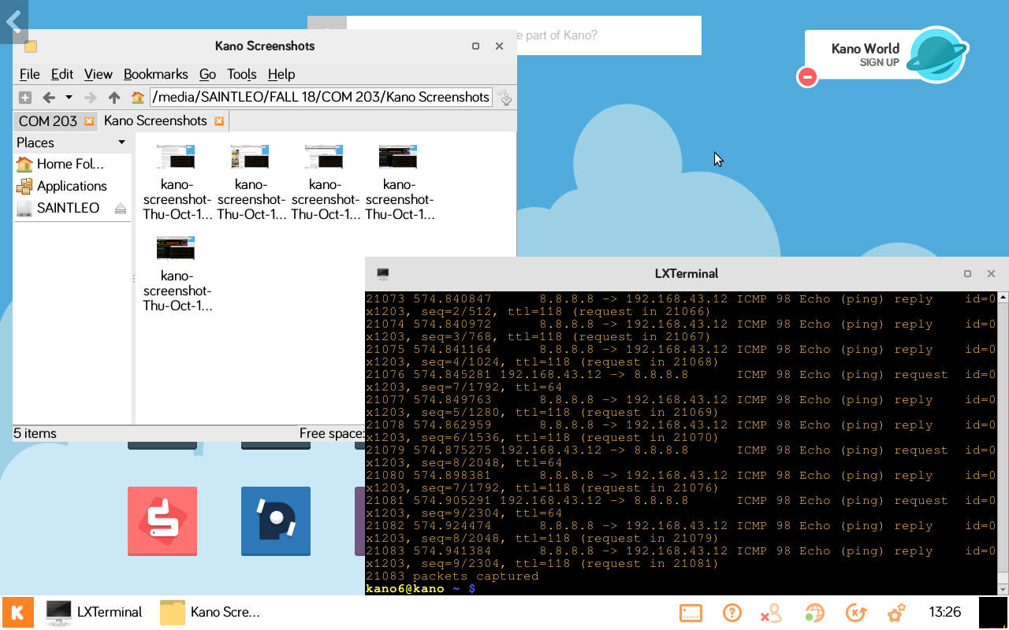
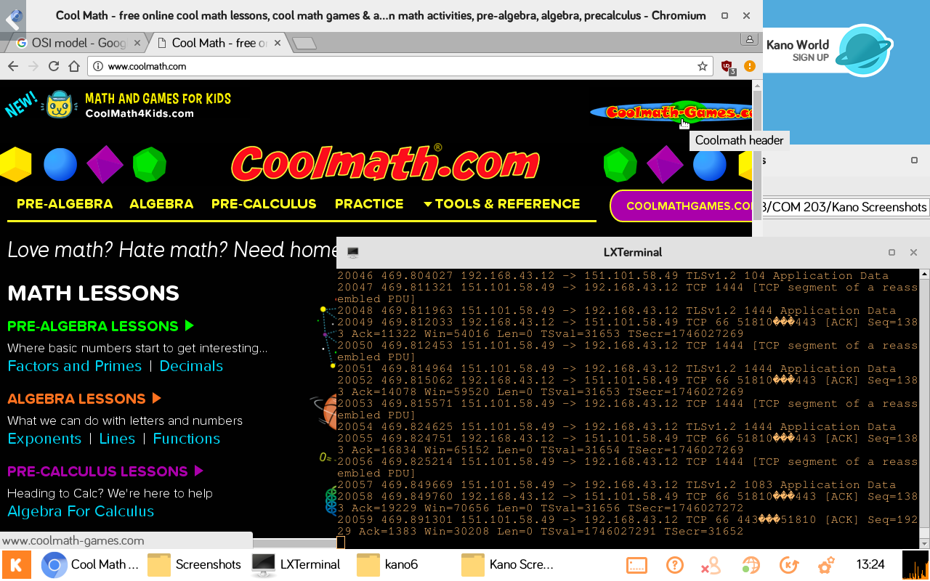

Slide 3
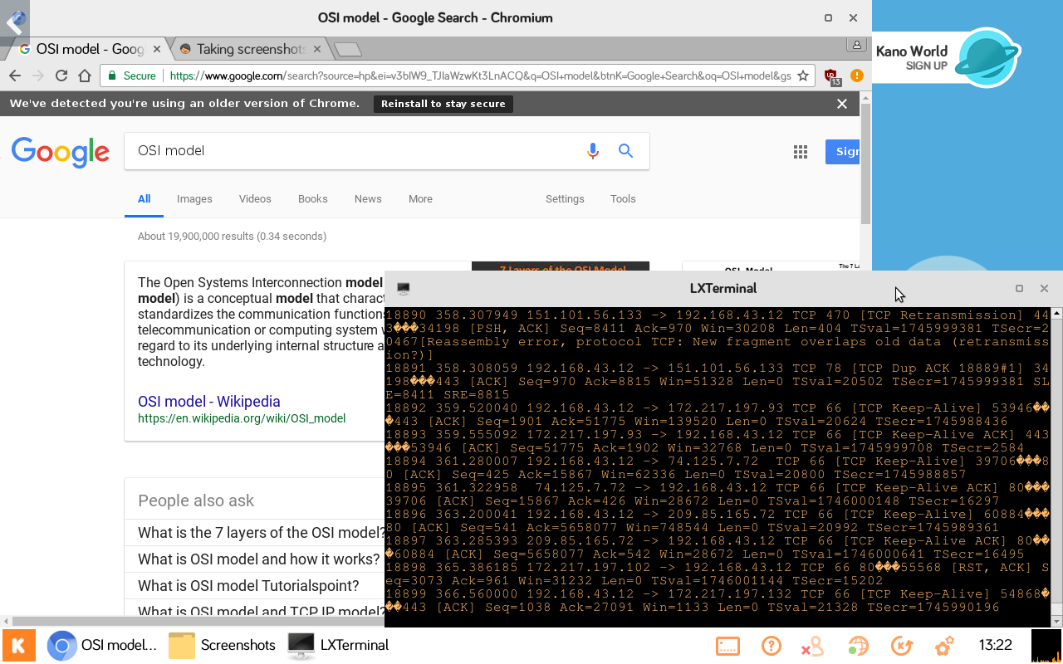
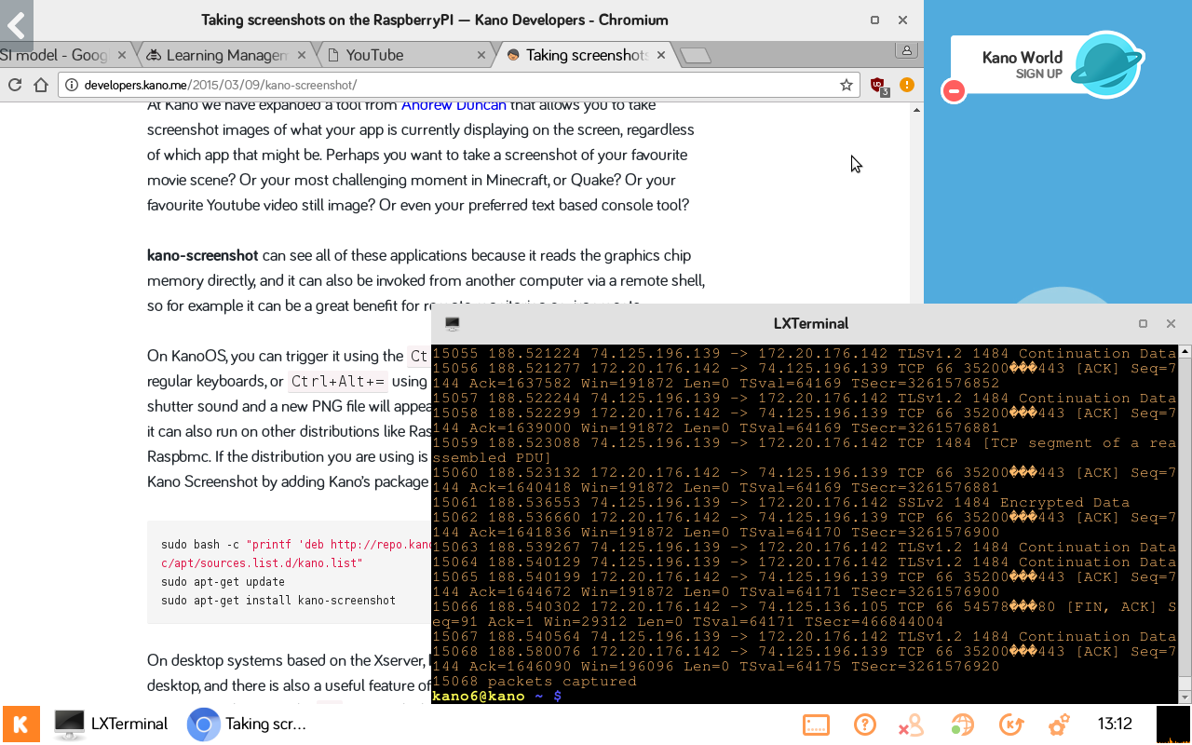
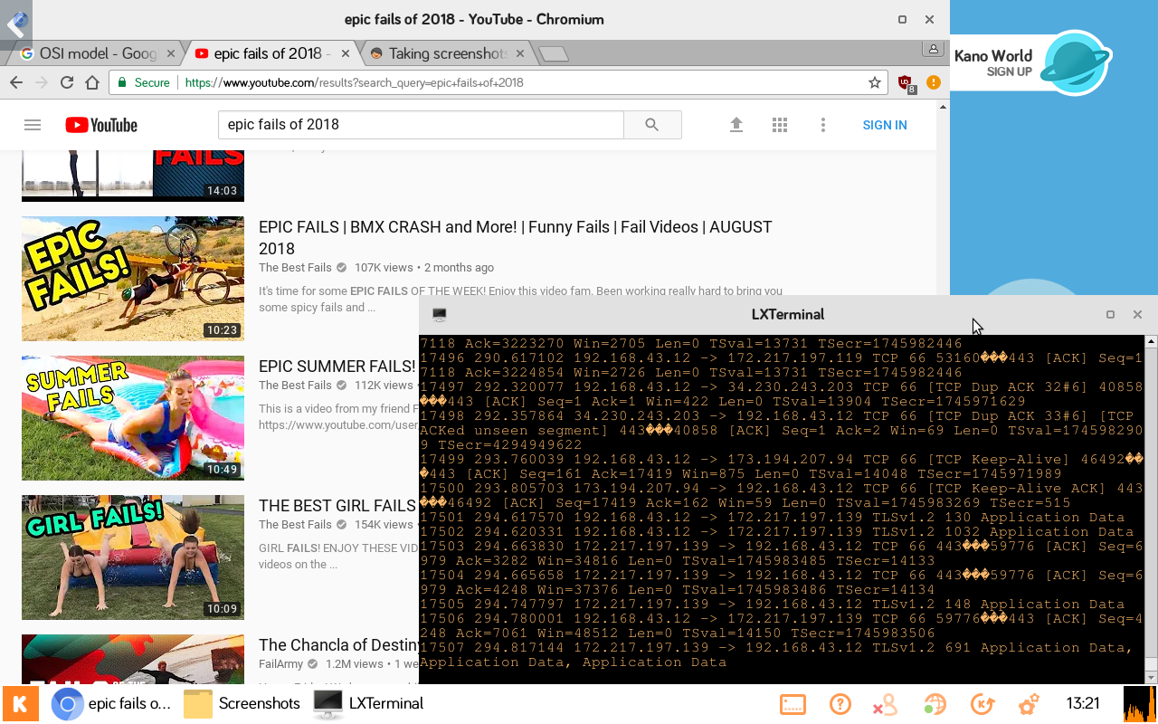

Slide 4
Our experience with Tshark was a special one. Like most of the Kano Kit projects this semester, we ran into a lot of trouble at first, but we were eventually able to resolve the issues with our kit and get Tshark to run properly. Once we got it working though, it was actually pretty interesting to see the number of packets that were moving between our kit and an outside server (the outside server being whatever website we chose to visit).

